Slide 1
Variables & Expressions
Chapter 2.1 (PART 1)

Slide 2
Variables and Expressions: Outline
Variables
Data Types
Java Identifiers
Assignment Statements
Simple Input
Simple Screen Output
Constants
Named Constants

Slide 3
Variables
Variables store data such as numbers and letters.
Think of them as places to store data.
They are implemented as memory locations.
The data stored by a variable is called its value.
The value is stored in the memory location.
Its value can be changed within the program.
… as opposed to “named constants” whose values can not be changed

Slide 4
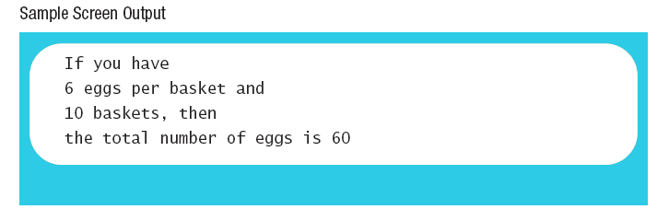
Variables
Name some variables used in this program
numberOfBaskets, eggsPerBasket, totalEggs
public class EggBasket
{ public static void main (String [] args)
{ int numberOfBaskets, eggsPerBasket, totalEggs;
numberOfBaskets = 10;
eggsPerBasket = 6;
totalEggs = numberOfBaskets * eggsPerBasket;
System.out.println ("If you have");
System.out.println (eggsPerBasket +
" eggs per basket and");
System.out.println (numberOfBaskets + " baskets, then");
System.out.println ("the total number of eggs is " +
totalEggs);
}
}
What do you think this would mean?
eggsPerBasket = eggsPerBasket -2;
It would subtract 2 from the current value of eggsPerBasket making it 6
Sample Screen Output
Notes:
Instructor Notes:
Emphasize that = is used as an assignment operator, it is NOT exactly like the = in mathematics.

Slide 5
Variable Declaration - Syntax and Examples
A variable has a type and a name.
Syntax
type variable_1, variable_2, …;
(variable_1 is a generic variable called a syntactic variable)
Examples
int styleChoice, numberOfChecks;
double balance, interestRate;
char jointOrIndividual;
String CustomerName;

Slide 6
Naming and Declaring Variables
A variable must be declared before it is used.
When you declare a variable, you provide its name and type.
Choose names that are helpful such as count or speed, but not c or s.
A variable's type (int, double, char, String, etc.) determines:
what kinds of values it can hold
how much space needs to be allocated in memory, i.e, it determines the number of bytes (size) it will occupy.
Notes:
Instructor Notes:
Explain a bit how variables are stored in memory.
Recap that memory is divided into bytes (8 bits)
And that addresses are sequential.

Slide 7
Java Identifiers
But NOT only variables
An identifier is a name, such as the name of a variable.
Identifiers may contain only
Letters
Digits (0 through 9)
The underscore character (_)
And the dollar sign symbol ($)
which has a special meaning, try to avoid using it
The first character cannot be a digit.
An identifier can not be a reserved word.
Could be the name of a class, or a method, or a constant, etc.

Slide 8
Keywords or Reserved Words
Words such as if are called keywords or reserved words and have special, predefined meanings.
Cannot be used as identifiers.
See Appendix 1 for a complete list of Java keywords.
Example keywords: int, public, class

Slide 9
Java Identifiers
Identifiers may not contain any spaces, dots (.), asterisks (*), or other characters:
7-11 oracle.com util.* (not allowed)
Identifiers can be arbitrarily long.
Since Java is case sensitive, stuff, Stuff, and STUFF are different identifiers.

Slide 10
Naming Conventions
Identifier for … | convention | example
Class types | begin with an uppercase letter | String
Primitive types | begin with a lowercase letter | int
Variables | begin with a lowercase letters | number
 | separating words within a multiword identifier with a capital letter | myName
Named Constants | are written in ALL captials | PI
 | separating words within a multiword identifier with the underscore _ | MAX_SECTION_SIZE

Slide 11
Where to Declare Variables
Declare a variable
Just before it is used or
At the beginning of the section of your program that is enclosed in {}.
public static void main(String[] args)
{ /* declare variables here */ . . . }
Notes:
Instructor Notes:
Point out /* */ is a comment
We can also use //

Slide 12
Data Types
In Java there are:
Class types
Primitive types
A class type is used for a class of objects and has both data and methods.
"Java is fun" is a value of class type String
A primitive type is used for simple, non-decomposable values such as an individual number or individual character.
int, double, and char are primitive types.

Slide 13
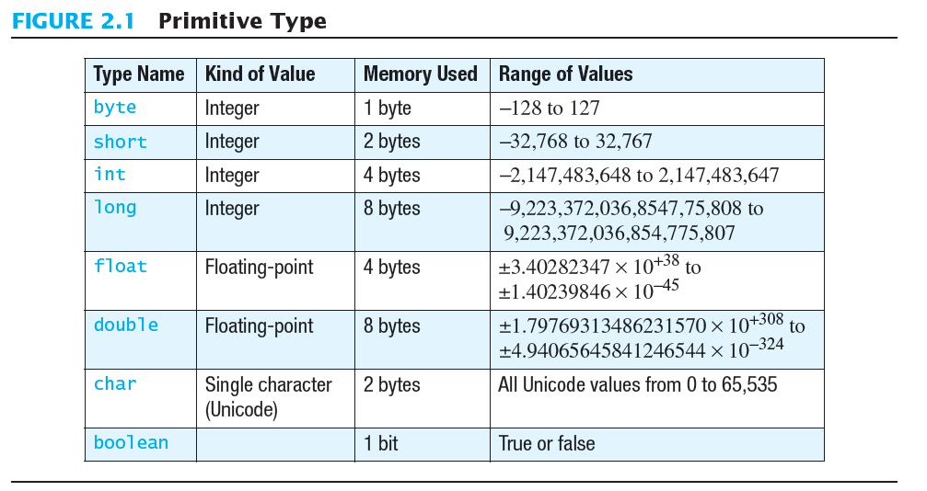
Primitive Types
Notes:
Instructor Notes:
Students should notice the increment in size of each type. And they should try to memorize the sizes.
The range of values, should be noticed, but not memorized.
Briefly explain why 1 byte holds from -128 to 127 (2^8=256, half for negative, other half for zero and the rest).
A short holds approx +/-32000, int much more, etc.
Floats and doubles hold larger numbers in the same amount of bytes as ints and longs respectivley, but the precision varies.
A boolean would most likely occupy a whole byte.

Slide 14
Primitive Types
Integer types
Four types: byte, short, int, and long
int is most common
Floating-point types
Two types: float and double
double is more common
One character type (char)
One boolean type (boolean)

Slide 15
Examples of Primitive Values
Integer types
0 -1 365 12000
Floating-point types
0.99 -22.8 3.14159 5.0
Character type
'a' 'A' '#' ' '
Boolean type
true false

Slide 16
Assignment Statements
An assignment statement is used to assign a value to a variable.
answer = 42;
The "equal sign" is called the assignment operator.
We say:
"The variable answer is assigned a value of 42"
Or "answer is assigned 42.“
Or “We assigned 42 to the variable answer"

Slide 17
Assignment Statements
Syntax
variable = expression;
where expression can be:
another variable,
a literal (such as a number),
or something more complicated which combines variables and literals using operators (such as + and -)
Notes:
Literal means constant

Slide 18
Assignment Examples
amount = 3.99;
firstInitial = 'W';
score = numberOfCards + handicap;
eggsPerBasket = eggsPerBasket - 2;
Do you think these are possible?
amount = “three”;
amount = 3.0;
amount = 3;
What do you think it depends on?
Notes:
Instructor Notes:
Explain:
The expression on the right-hand side of the assignment operator (=) is evaluated first.
The result is used to set the value of the variable on the left-hand side of the assignment operator.
score = numberOfCards + handicap;
eggsPerBasket = eggsPerBasket - 2;
Answer to the question is:
Depends on the data type … and will be explained ahead (coercion, casting, etc.)

Slide 19
Initializing Variables
A variable that has been declared, but no yet given a value is said to be uninitialized.
Uninitialized class variables have the value null.
Uninitialized primitive variables may have a default value.
It's good practice not to rely on a default value.
To protect against an uninitialized variable, assign a value at the time the variable is declared.

Slide 20
Initializing Variables
syntax
type variable_1 = expression_1,
variable_2 = expression_2, …;
example
int eggsPerBasket = 5;
double sales = 34557903.75;
float GPA = 4.23f;
What is the f at the end of the number?
In Java, double is the default type of a floating-point number.
When using float literals, the number should be written as shown; otherwise, the compiler would give an error message (syntax error)
It has to do with the compatibility of the types … explained ahead

Slide 21
Simple Input
Sometimes the data needed for a computation are obtained from the user at run time.
Keyboard input requires
import java.util.Scanner
at the beginning of the file.

Slide 22
Simple Input
Data can be entered from the keyboard using Scanner keyboard =
new Scanner(System.in);
followed, for example, by
eggsPerBasket = keyboard.nextInt();
which reads one int value from the keyboard and assigns it to eggsPerBasket.

Slide 23
import java.util.Scanner;
public class EggBasket2
{ public static void main (String [] args)
{ int numberOfBaskets, eggsPerBasket, totalEggs;
Scanner keyboard = new Scanner (System.in);
System.out.println ("Enter the number of eggs in each basket:");
eggsPerBasket = keyboard.nextInt ();
System.out.println ("Enter the number of baskets:");
numberOfBaskets = keyboard.nextInt ();
totalEggs = numberOfBaskets * eggsPerBasket;
System.out.println ("If you have");
System.out.println (eggsPerBasket + " eggs per basket and");
System.out.println (numberOfBaskets + " baskets, then");
System.out.println ("the total number of eggs is " + totalEggs);
System.out.println ("Now we take two eggs out of each basket.");
eggsPerBasket = eggsPerBasket - 2;
totalEggs = numberOfBaskets * eggsPerBasket;
System.out.println ("You now have");
System.out.println (eggsPerBasket + " eggs per basket and");
System.out.println (numberOfBaskets + " baskets.");
System.out.println ("The new total number of eggs is " +
totalEggs);
}
}
Notes:
Notice we used totalEggs again
The values stored in memory will change at the location for totalEggs

Slide 24
Simple Input
View sample program listing 2.2 class EggBasket2
Sample screen output

Slide 25
Simple Screen Output
System.out.println("The count is " + count);
Outputs the sting literal "the count is "
Followed by the current value of the variable count.
Notes:
You will learn more about the “+” later

Slide 26
Constants (Literals)
Literal expressions such as 2, 3.7, or 'y' are called constants.
Integer constants can be preceded by a + or - sign, but cannot contain commas.
Floating-point constants can be written
With digits after a decimal point or
Using e notation.
The literal 3.0 is considered a floating-point constant; even though the value after the decimal point is 0, it is not an integer constant.

Slide 27
e Notation
e notation is also called scientific notation or floating-point notation.
Examples
865000000.0 can be written as 8.65e8
0.000483 can be written as 4.83e-4
The number in front of the e does not need to contain a decimal point.

Slide 28
Imprecision in Floating-Point Numbers
Floating-point numbers often are only approximations since they are stored with a finite number of bits.
Hence 1.0/3.0 is slightly less than 1/3.
1.0/3.0 + 1.0/3.0 + 1.0/3.0 is less than 1.

Slide 29
Named Constants
Java provides mechanism to …
Define a variable
Initialize it
Fix the value so it cannot be changed
Syntax:
public static final type identifier = Constant_value;
Example
public static final double PI = 3.14159;

